Slide 1

DriverPass System Analysis
Dhandeaka Harris-Kearse
Notes:
[No speaker notes required for this slide.]

Slide 2

System Requirements
Functional Requirements
Customers can schedule driving lessons online
Users can take practice tests and view results
Nonfunctional Requirements
System must be accessible online from any device
System must securely store user and payment data
Notes:
This system was designed to meet DriverPass’s main business needs. First, customers must be able to schedule driving lessons easily, whether online or through the office. This helps improve convenience and reduces manual scheduling work.
Second, the system allows users to take practice tests and track their progress. This supports DriverPass’s goal of helping customers pass their driving exams.
On the system side, it must be accessible from anywhere using a phone or computer, since the client wanted a cloud-based solution. Security is also very important because the system stores personal and payment information, so it must keep that data safe.

Slide 3
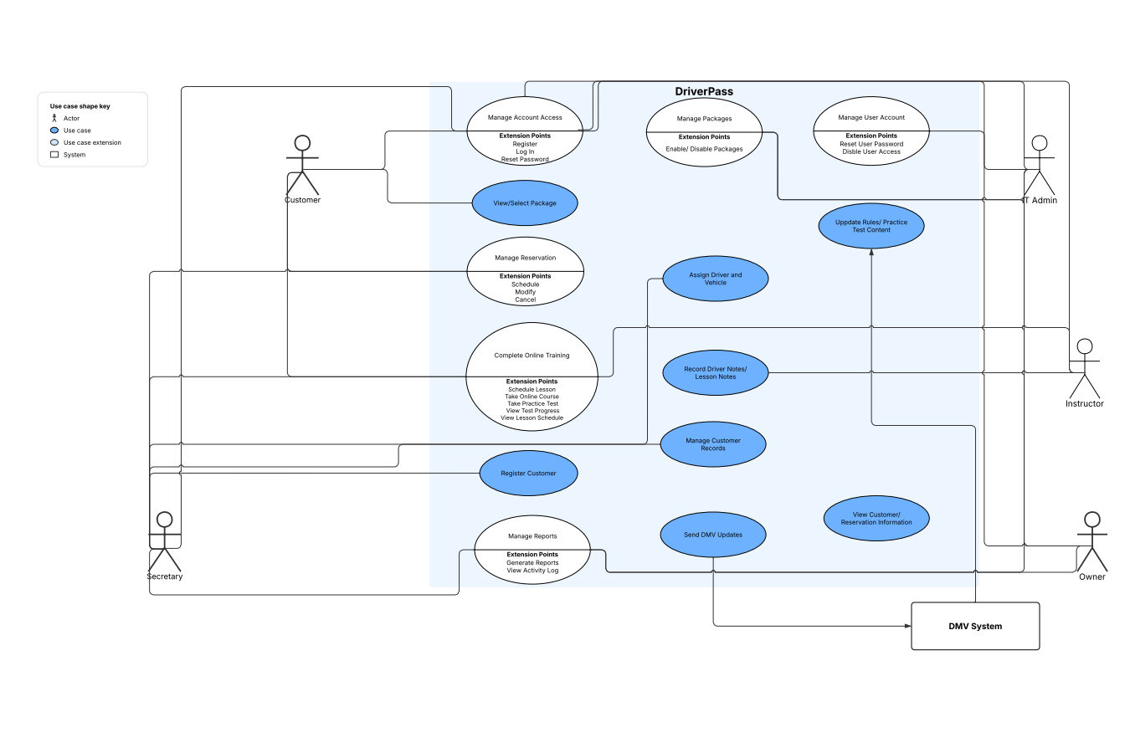
Use Case Diagram
Notes:
This diagram shows how different people interact with the system. For example, customers can create accounts, schedule lessons, and take practice tests. Staff members can manage reservations and help customers when needed.
The system also includes administrative functions, such as managing accounts and viewing reports. This allows the business owner to track performance and activity.
Overall, this design ensures that every user has access to the tools they need while keeping responsibilities clearly separated.

Slide 4
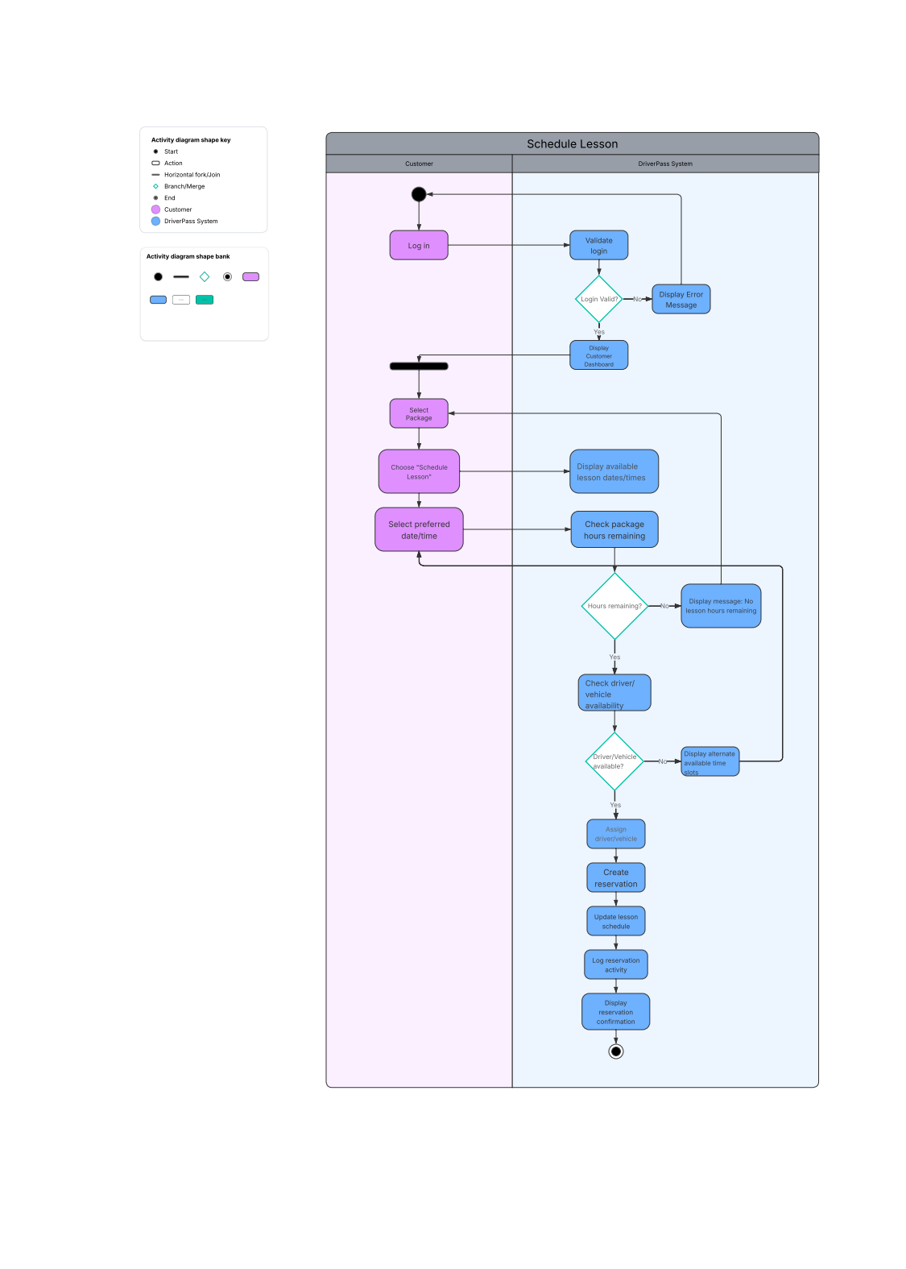
Activity Diagram
Notes:
This diagram breaks down the steps a customer takes to schedule a driving lesson. It starts with logging into the system and selecting a package. Then the system shows available times, and the customer chooses what works best.
Behind the scenes, the system checks if a driver and vehicle are available. If everything is available, the lesson is scheduled and confirmed. If not, the customer is asked to choose another time.
This design ensures that scheduling is efficient and avoids conflicts, which helps the business run smoothly.

Slide 5
Security
User login with secure passwords
Role-based access for employees
Activity tracking for all changes
Protection of personal and payment data
Notes:
Security was a major focus in this design. Every user must log in with a username and password to access the system.
Different users have different levels of access. For example, administrators can manage accounts, while customers can only manage their own information.
The system also keeps a record of actions, such as scheduling or canceling lessons. This helps track who made changes if issues arise.
Finally, personal and payment information is protected to ensure customer trust and safety.

Slide 6
System Limitations
Requires internet connection for full functionality
Limited customization of packages in current version
System updates require technical support
Dependent on external DMV updates
Notes:
Like any system, there are some limitations. First, the system depends on an internet connection for full functionality, especially when updating or saving data.
Second, while packages can be enabled or disabled, creating new ones requires technical support. This was kept simple for the initial version.
Additionally, updates to the system will require someone with technical knowledge. Lastly, the system relies on updates from the DMV, which are outside of the company’s control.
Even with these limitations, the system still meets the client’s main goals and provides a strong foundation for future improvements.

